Slide 1
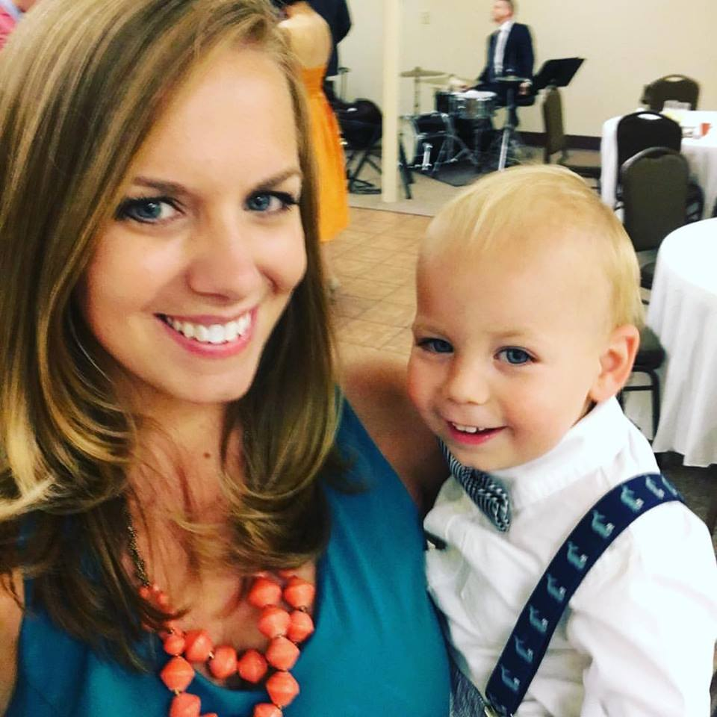
Mrs. Ramp!
I’m from Columbia, SC and I’ve been married for six years to my husband Jason.
We have a wonderful son called Henry (he’s nearly 3) and an angel baby called Molly Rose.

Slide 2
I completed my undergrad at the University of South Carolina and received a B.A. in English with minors in history and political science.
I did both of my master’s degrees at Augusta University and earned a 4.0 GPA for both.
2009—M.A. Secondary English
2011—Ed.S. Curriculum and Instruction.

Slide 3
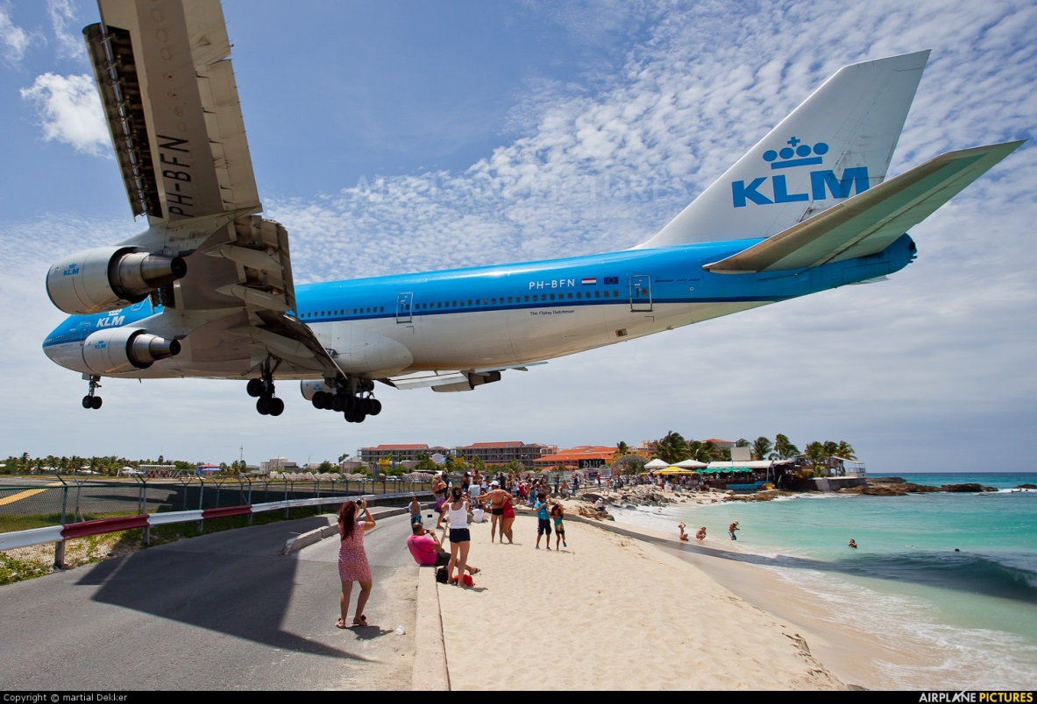
This is my first year at Roswell High school; before this, I taught 9th honors at Webb Bridge Middle School.
Before moving to North Fulton, I taught high school English at Dutch Fork High School in Columbia, SC and English/Social Studies at L.U. Preparatory School on the island of St. Maarten.

Slide 4
How are students supported?
Students use Office365 (OneNote)—if their Surface isn’t working, all of their work can be accessed through Office 365 online from any computer or device.
Students have access to my website and course calendar at offramp.weebly.com
Students are encouraged to check the course calendar for missed work when they are absent.
Please feel free to contact me at ramp@fultonschools.org ; students are encouraged to self-advocate and contact me if a problem arises.

Slide 5
What is the current unit?
Students are starting on a major literary analysis paper to round out our short story unit. Students will be given time in class for peer editing.

Slide 6
How are grades assigned?
Formative/Minor Assessments (Daily Work/Quizzes): 30%
Summative/Major Assessments (Tests, Projects, Essays): 50%
Final Exam (December): 20%
This course finishes with an EOCT (end of course test); it will be in May of 2018 and will count for 20% of their semester two score.
Assignments are always due at the beginning of class. Late homework and classwork are not accepted.
Major assignments (papers, projects, etc.) will be accepted late for a penalty of 10% per day. After the third day, major assignments are not accepted.

Slide 7
What’s coming up next?
Please purchase a copy
of our two upcoming novels;
we will be annotating them.

Slide 8
Grammar and Vocabulary
Students are assigned 90 SAT-oriented vocabulary words each semester which are assessed through various quizzes.
A pre-diagnostic grammar test was given in August. The data taken from that test is now driving our instruction. A post-test will be given in May.
We work on breaking down sentences in class (part of speech, function, clauses, etc.) and students will be quizzed over grammar once per month. I have grammar help sessions every Wednesday at 7:45 AM (or by appointment!).

Slide 9
How can parents help?
Classroom supplies are always appreciated!
Boxed tissue
Hand sanitizer
Dry erase markers
Dry Erase Markers
Anti-bacterial wipes

Slide 10
1.) Come to class fully prepared (books, writing implements, notes)
You will NOT be allowed to return to your locker (or another class) for anything once class has begun.

Slide 11
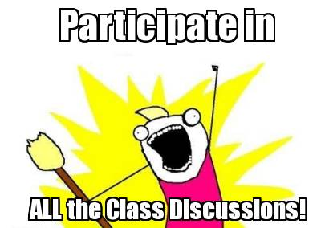
2.)
Equity sticks—your new best friend!

Slide 12
‘Others’ most definitely includes your teacher.
3.)

Slide 13
4.) Sidebar conversations

Slide 14
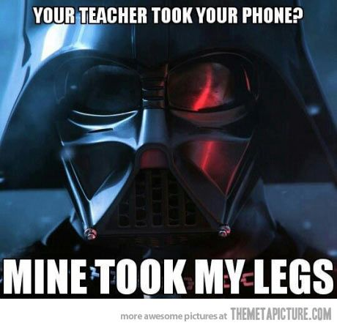
5.)
When you enter class, you will place your phone in the red parking lot. If you have a second phone and I see it/hear it, it’s mine. You’ll get it back at the end of the day/week…unless, of course, I’ve asked you to pull them out for an assignment.

Slide 15
6.) Put your name (first and last) and class period on every assignment if you want credit for it.

Slide 16
7.) Stay in your seats/do not pack up until I dismiss you.

Slide 17
8.) Raise your hand if you
a question or leave your seat.

Slide 18
9.) Listen to instructions

Slide 19
10.) Bathroom privileges
No one is allowed to go to the bathroom during the FIRST and LAST ten minutes of class (because really important instructions happen during that time). If privileges are being abused, I reserve the right to take them away.

Slide 20
Not sure? Ask me after class. ☺
Okay, there ARE a couple of classic “stupid” questions:
A question about something that is clearly written on the board.
A question that I just answered a moment before (but you weren’t listening)
Don’t be offended if the entire class groans/face palms if you ask one of these.

Slide 21
I can’t wait to get started!

